Slide 1

Welcome to GAMING WORLD
Hashtag

Slide 2


Team Members
OG LEADER
Aniket Chowdhury (11900121111)
Pushan Karmakar (11900121079)
Rajesh Kumar (11900121072)
Sanjoy Dey (11900121092)
Pritam Chakraborty (11900121103)
Arkapriya Chanda (11900121076)
Sudipta Sarkar (11900221004)
Bikash Sah (Lateral)
Prahlad Biswas (Lateral)
2
8
1

Slide 3



Device Specifications
Model : Dell G5 5500
Processor : i5 10th Gen
RAM : 12GB DDR4
Graphics : 4GB NVIDIA GTX 1660Ti
Storage : 512 GB SSD + 1 TB HDD

Slide 4


Resources
Tools Used
Language
BlueJ
Eclipse
AWT
Swing
JPanel
Scanner
JAVA

Slide 5
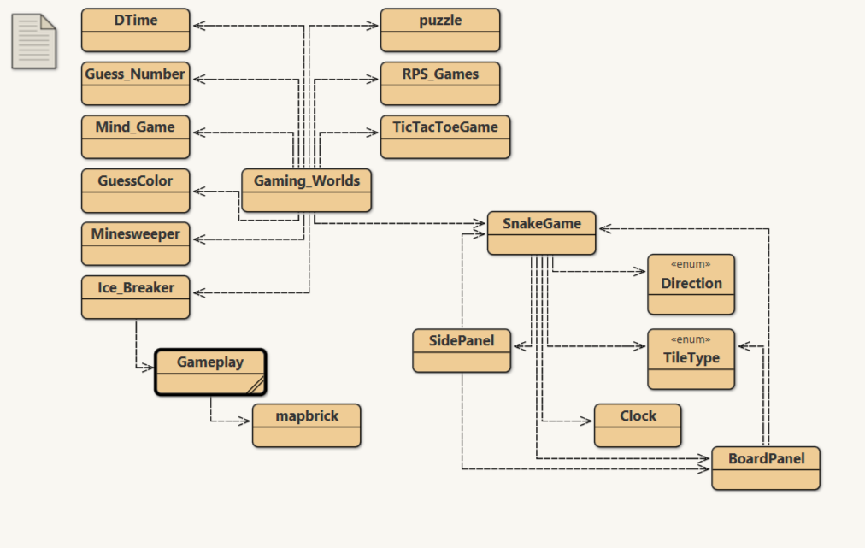
Project Tree
PROJECT TITLE : Gaming_World
PURPOSE OF PROJECT : Learn new Things
VERSION or DATE : 15 Sep, 2022
HOW TO START THIS PROJECT : Hands
AUTHORS : Hashtag
USER INSTRUCTIONS : Hello World

Slide 6
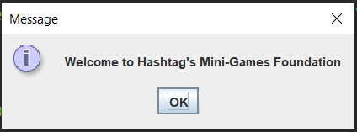
This is the Welcome Screen of our Program
6

Slide 7
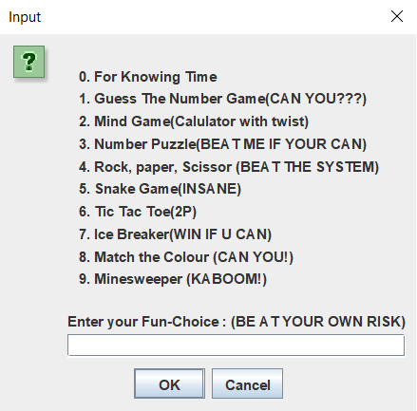
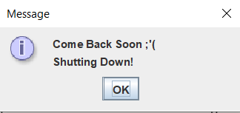
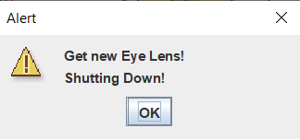
Here we take the input for choosing the games from our program to Play
7

Slide 8
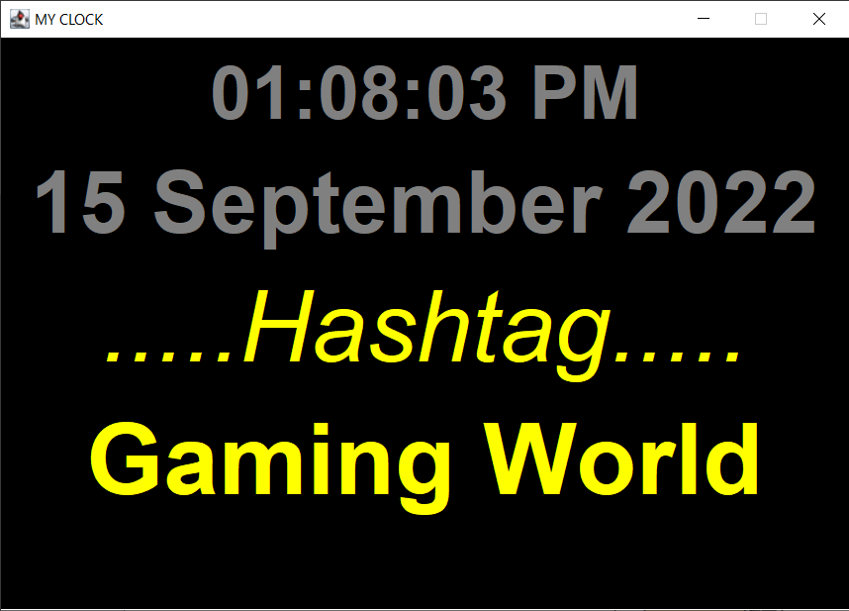
This is the 0th Position Program from our set of Programs. It shows the current Date and Time.
8

Slide 9
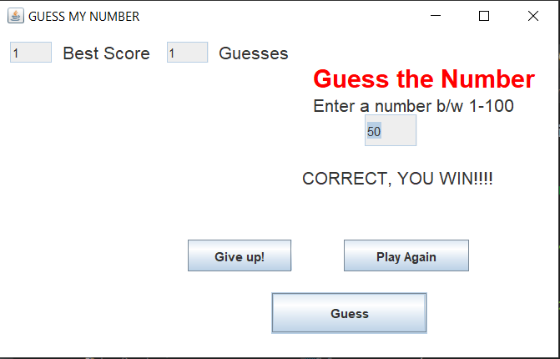
This is the 1st Game from our Program. Here you have to guess the right number.
9

Slide 10
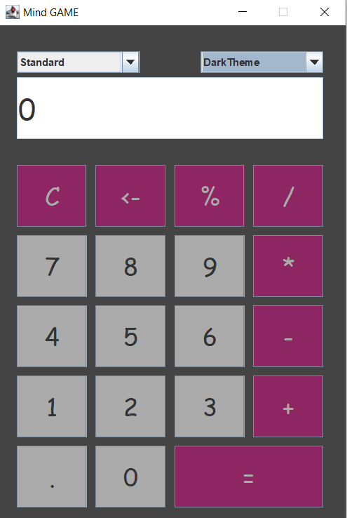
This is the 2nd Game from our Program. Here you have to think 2 random numbers, and we can do any Arithmetic Operations between them. Hence, I.Q. increases.
10

Slide 11
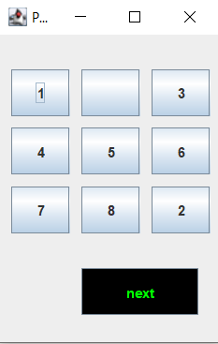
This is the 3rd game of our Program. It is a number Puzzle Game. Solve it if you can!
11

Slide 12
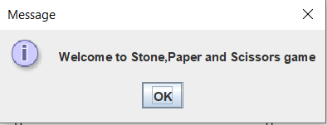
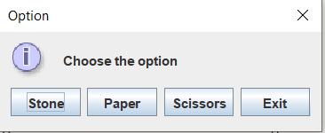
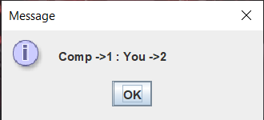
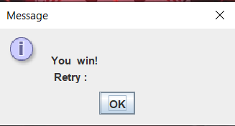
This is the 4th Game of our Program. Stone, Paper, Scissors. Can you Beat the SYSTEM!
12

Slide 13
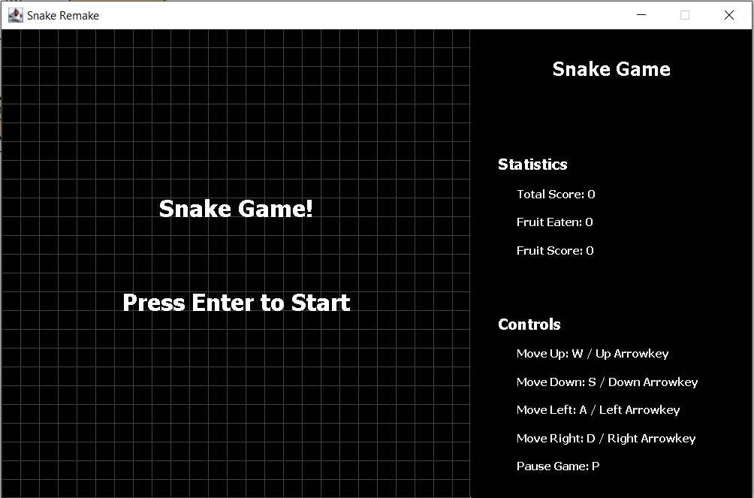
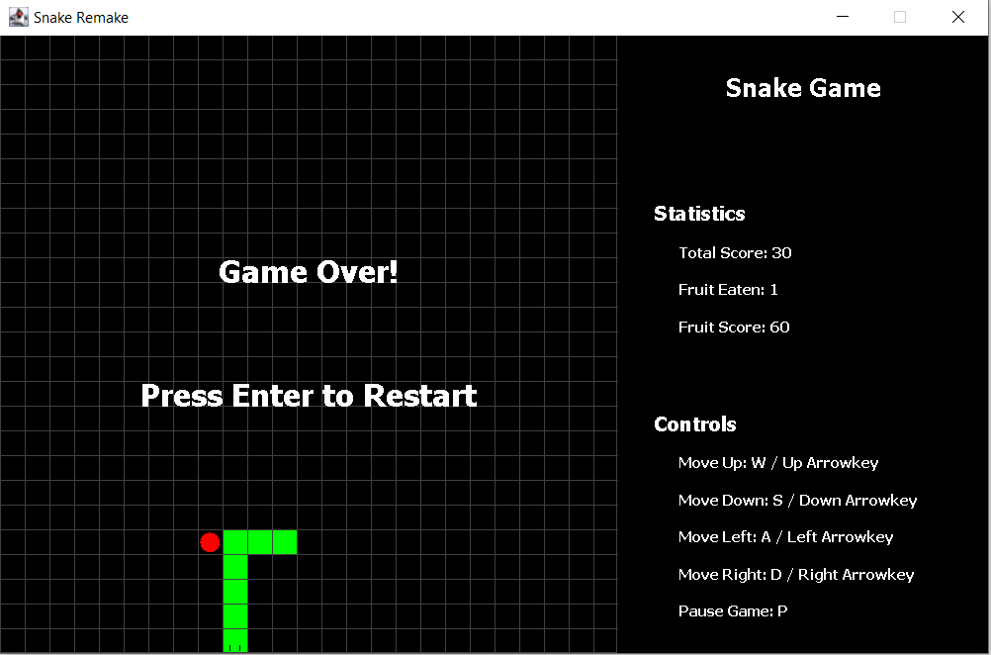
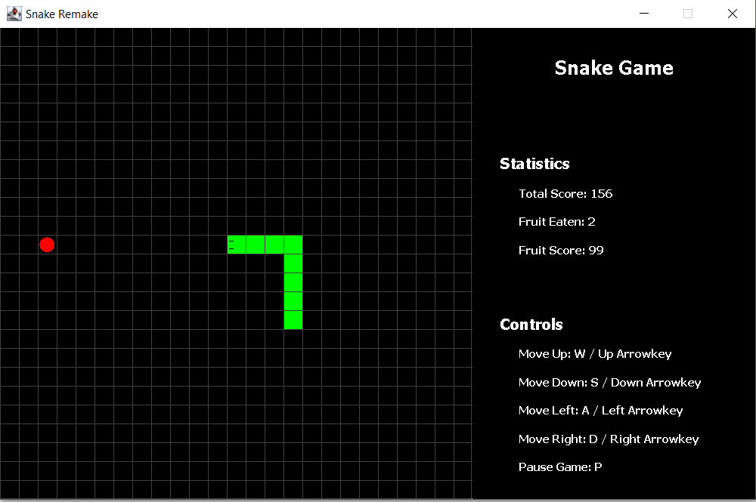
This is the 5th Game of our Program. Here you have to trail behind the red dot and consuming that will increase your snake’s length.
13

Slide 14
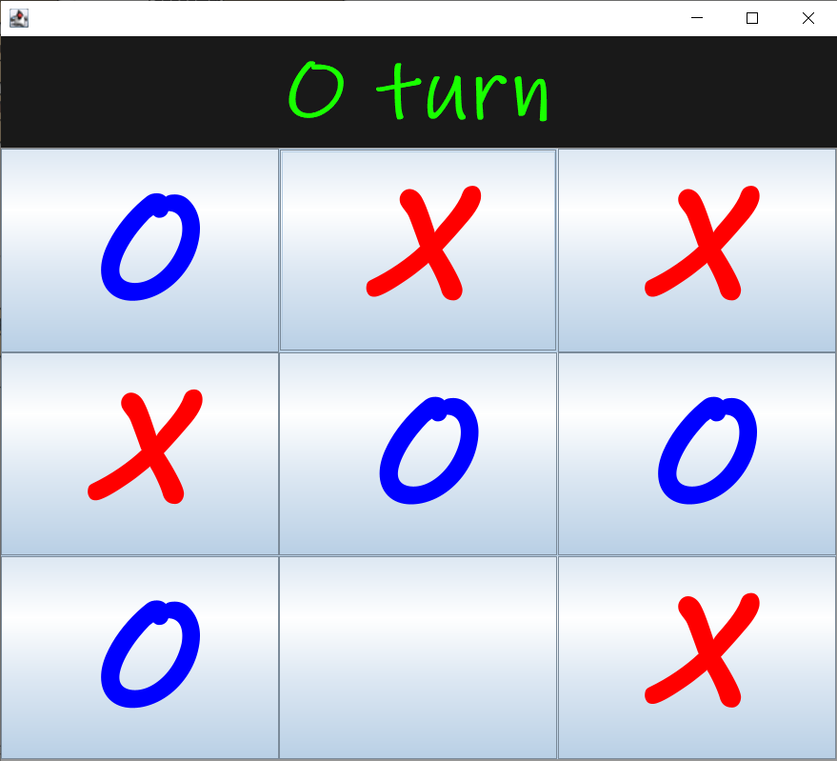
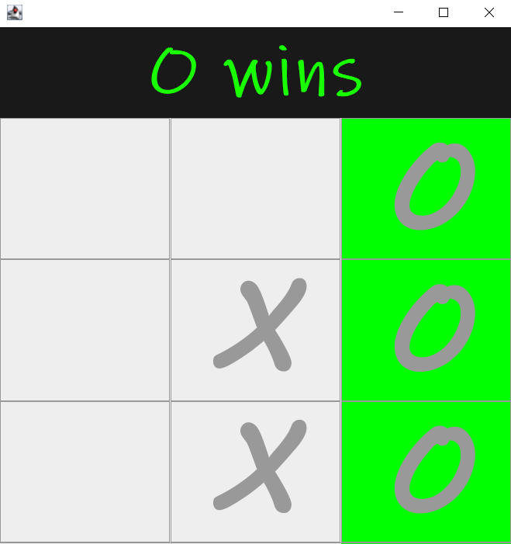
This is the 6th Game of our Program named as TicTacToe. This is a 2 player game in which two players take turns in drawing either an ‘O' or an ‘X’ in one square of a grid consisting of nine squares. The winner is the first player to get three of the same symbols in a row.
14

Slide 15
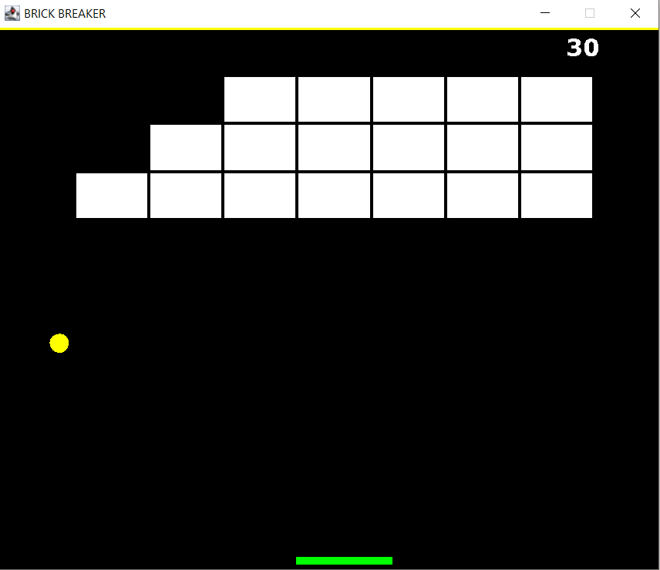
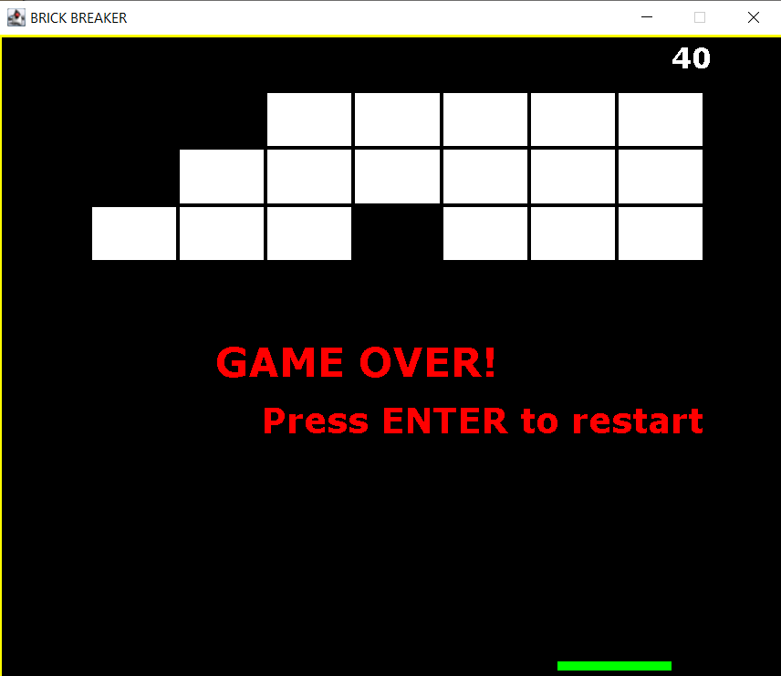
This is the 7th Game of our Program. Here you have to protect the jumping ball from landing on the floor until all the blocks gets destroyed to win.
15

Slide 16
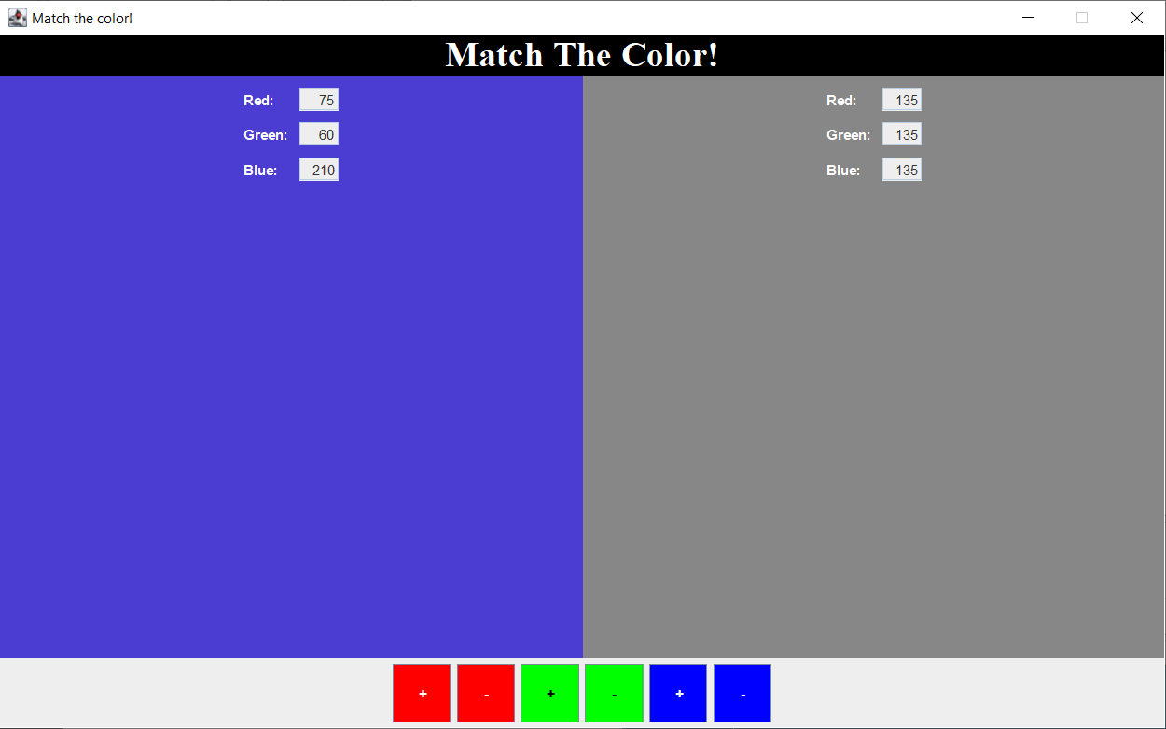
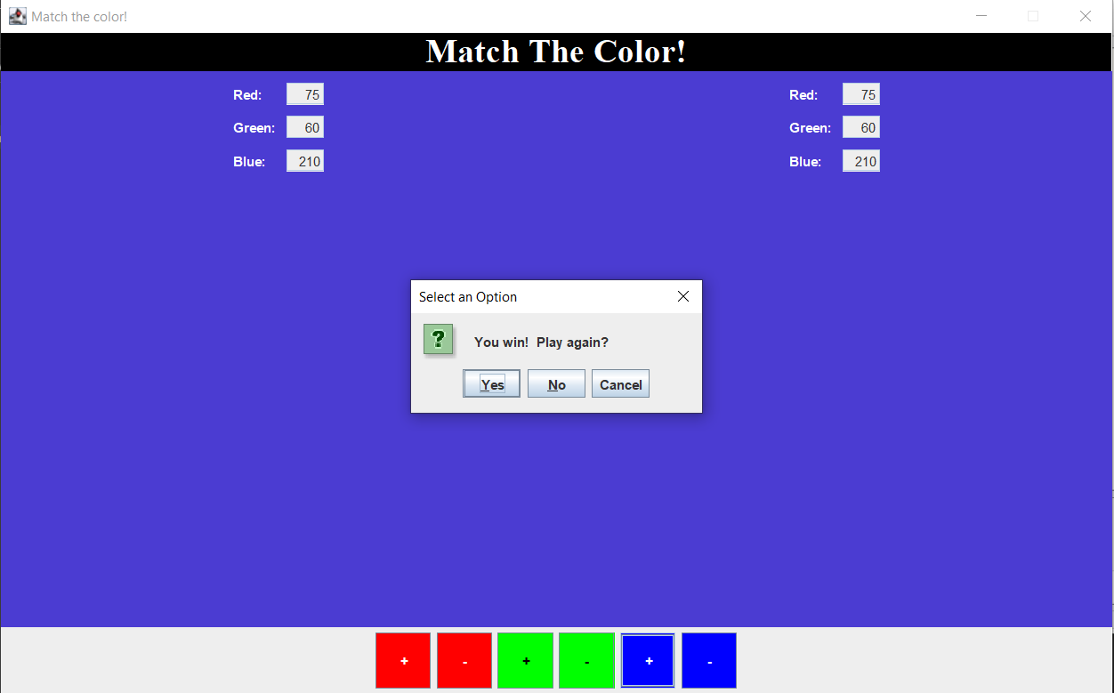
This is the 8th Game of our Program. Here you have to match the Colour in the Left side by mixing colours RED GREEN BLUE
16

Slide 17
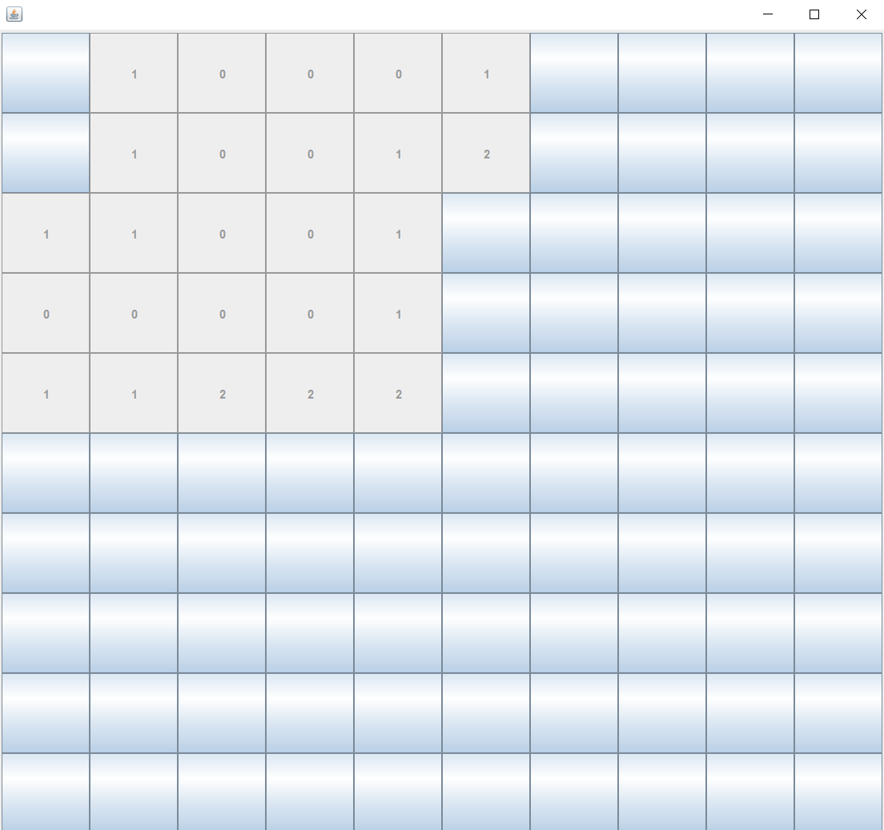
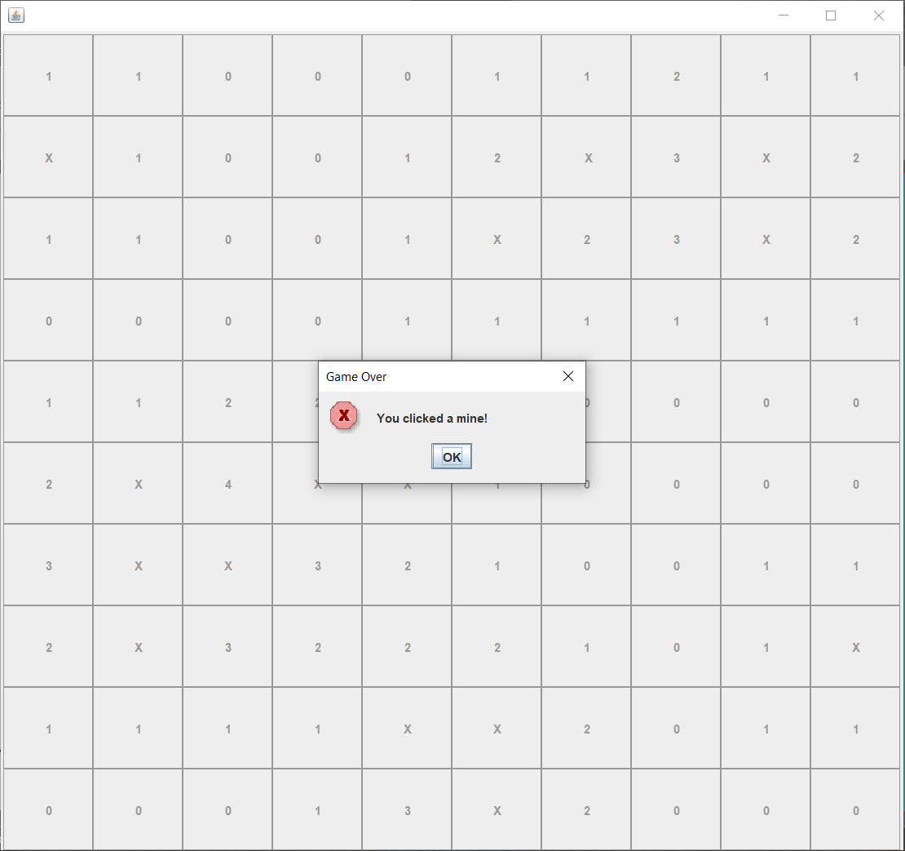
This is the 9th^{th} and Last Game of our Program(for now). Here is the very Familiar Game from Win XP “Minesweeper” WIN IF YOU CAN!
17

Slide 18
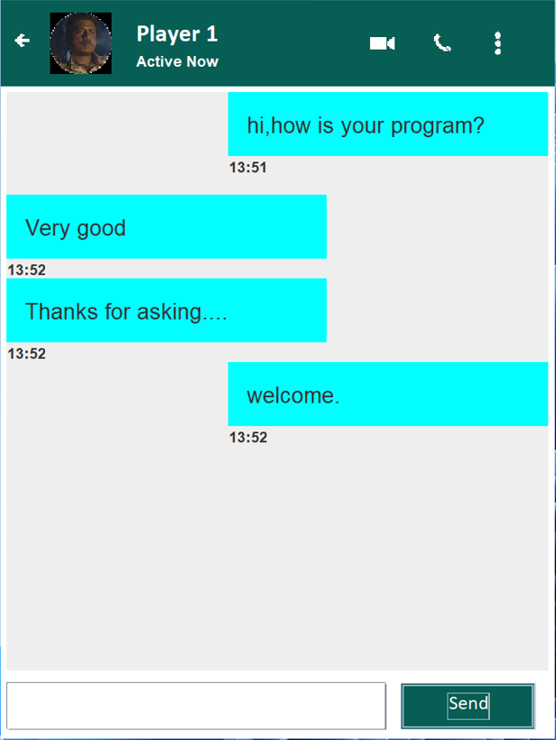
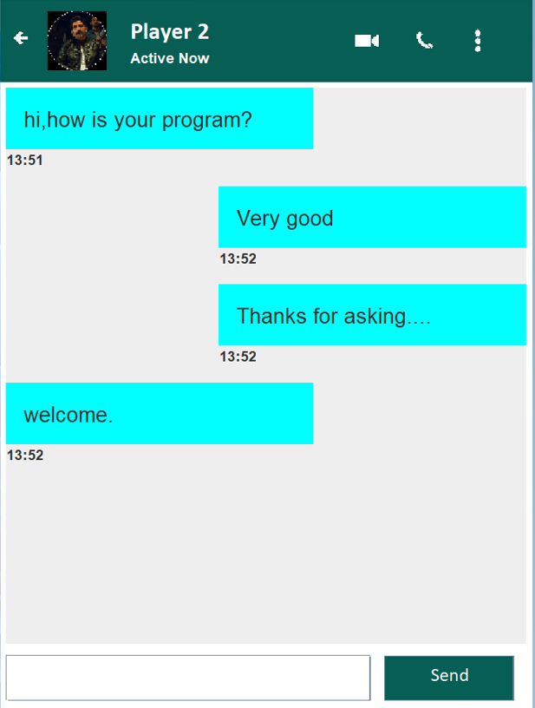
This is Our Special Chat Service which helps our user to communicate with their fellow players in real-time.
18

Slide 19
Future Scope
There is enormous Scope of JAVA and its applications. Our Project can be implemented using Android and more vast libraries. GUI will be more smooth and more menus to go through.

Slide 20

THE END
Reference :
Brocode.com
Stackoverflow.com
Github.com
Javapoint.com
wikipedia.com
20
1
2
3
4
5

